Slide 1




AIRAWARE SMART AIR QUALITY PREDICTION SYSTEM
Presented by: likhitha karri
MENTOR: SHAKTHI GOPALKRISHNAN

Slide 2

INTRODUCTION
• AirAware is an intelligent dashboard designed to monitor and predict air quality across Maharashtra.
• It visualizes real-time AQI levels, pollutant concentrations, and historical trends using interactive charts.
• The system simulates machine learning predictions to estimate short-term and long-term air quality changes.
• It demonstrates how data analytics and ML can support environmental awareness and public health decisions.
• Built using modern web technologies with scope for future integration of real datasets and backend ML models.

Slide 3

PROJECT AGENDA
  air aware is a smart system that designed to monitor and predict air quality using data analysis & machine learning

Slide 4

OVERVIEW
•The AirAware Smart Air Quality Prediction System is designed to monitor and predict air quality using IoT sensors, AI, and cloud technology.
•The system provides real-time insights and alerts to help users take preventive measures for better health and safety.

Slide 5

OBJECTIVES
•Monitor air quality parameters (PM2.5, PM10, CO2, humidity, temperature)
•Predict future air quality levels using Machine Learning
•Provide real-time dashboards and notifications
•Help in decision-making for environmental management

Slide 6
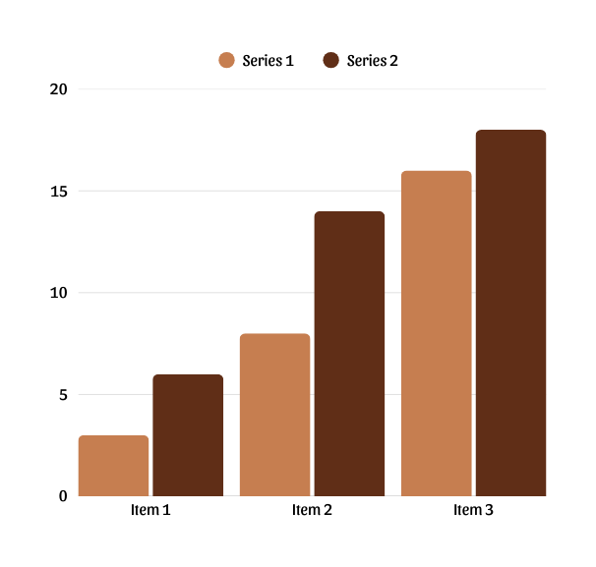
SYSTEM ARCHITECTURE
•The project is divided into five main layers:
•1. Sensor Layer – Collects air quality data
•2. IoT Gateway – Sends data to cloud
•3. Backend Layer – Handles storage and ML model
•4. Frontend Layer – Displays live data and alerts
•5. Cloud – Ensures real-time data access and scalability

Slide 7
HOW THE CODE WORKS
  This code handles station switching, chart updates, and AQI recalculation.
  function updateStation(key){
  const s = stations[key];
  document.getElementById('stationName').textContent = s.name;
  document.getElementById('aqNum').textContent = s.aqi;
  gauge.destroy();
  gauge = createGauge(gaugeCtx, s.aqi);
  const newHourly = hourlyData.map(x =>
  Math.max(10, Math.round(x * (s.aqi/80))));
  hourlyChart.data.datasets[0].data = newHourly;
  hourlyChart.update();

Slide 8
TECHNOLOGIES
ML MODELS
• HTML5 for structure
• CSS3 for custom UI & layout
• JavaScript (Vanilla) for logic
• Chart.js for charts & visualizations
• Random Forest
• Gradient Boosting
• LSTM (Deep Learning Time-Series Model)
• Predicts AQI category: Good, Moderate, or Poor

Slide 9
DATA SET
DATABASE
•Dataset: Air quality data collected from open sources like UCI Machine Learning Repository or Kaggle
•Features include PM2.5, PM10, CO2, humidity, temperature, and weather conditions
•Data is used to train and test the ML model
•Example: Air Quality Dataset (Beijing, 2018–2020)
•Database used: MySQL / MongoDB
•Stores sensor data, prediction results, and user information
•Key tables:
• - Sensor_Data (PM2.5, CO2, Temp, Timestamp)
• - Predictions (AQI, Category, Confidence)
• - Alerts (Alert_ID, Type, Time)

Slide 10
FRONTEND
BACKEND
•Developed using HTML, CSS, JavaScript (or React.js)
•Displays real-time AQI values and trend graphs
•Includes a user-friendly dashboard with color-coded AQI indicators
•Provides alerts and reports on air quality conditions
•Backend built using Python (Flask/Django)
•Handles data processing, ML model integration, and APIs
•Connects with cloud storage and database for real-time updates
•Provides RESTful APIs for the frontend dashboard

Slide 11
FUTURE ENHANCEMENTS
•Connect real APIs for live data
•Build backend (Python FastAPI + ML Models)
•Deploy on cloud (AWS / GCP / Render)
•Add alerts, AQI heatmaps, forecasting dashboard

Slide 12
CONCLUSION
•The AirAware Smart Air Quality Prediction System integrates fast API, python, and Machine Learning to create a complete solution for air pollution monitoring.
•It helps users make data-driven decisions, promotes environmental awareness, and contributes to healthier living conditions.

Slide 13
THANK YOU

